Slide 1
Asymmetric Encryption
Dylan Schroers

Slide 2
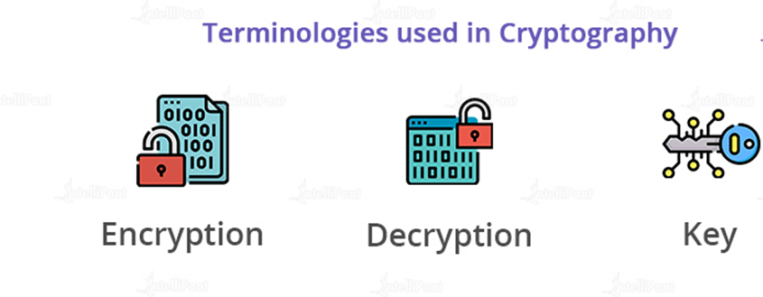
Introduction
Uses two ‘keys’ to encrypt and decrypt information
Public key encryption
Anyone can see and use this key
Private key encryption
Only the intended recipient has this key
Differs from symmetric encryption
Asymmetric encryption provides greater security than symmetric encryption

Slide 3
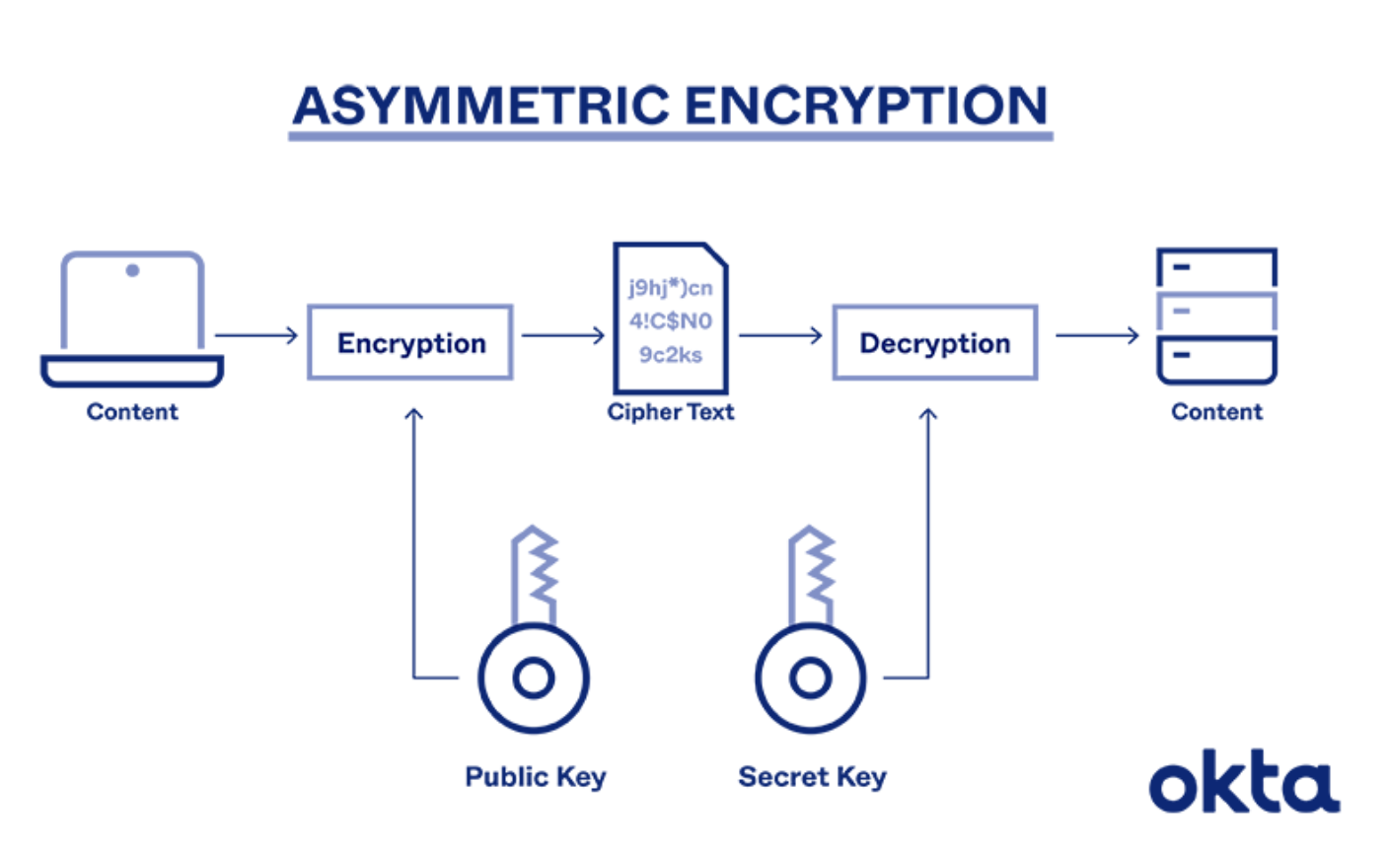
Position
The keys are generated using a mathematical algorithm
Generating the keys goes through 5 steps:
Registration:
connect with an official entity
Lookup:
Sender gets the recipient's public key information.
Encrypt:
Sender encrypts msg with the recipient's public key,
Decode:
Recipient uses private key to decode the message.
Reply:
If recipient wants to respond, the process moves in reverse.

Slide 4
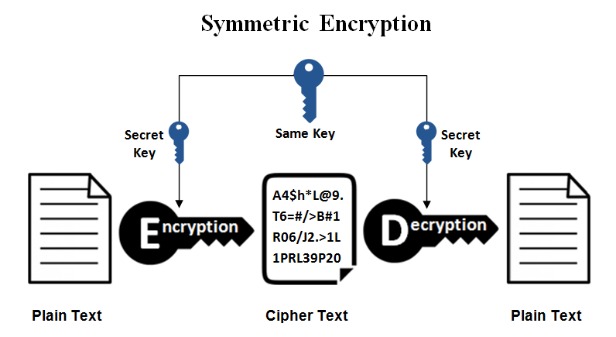
Reason
Varies from symmetric encryption:
Uses one key to both encrypt and decrypt information
Less secure - lost key will be able to read and send any message
Faster but less secure
Typically used to send large amounts of data

Slide 5
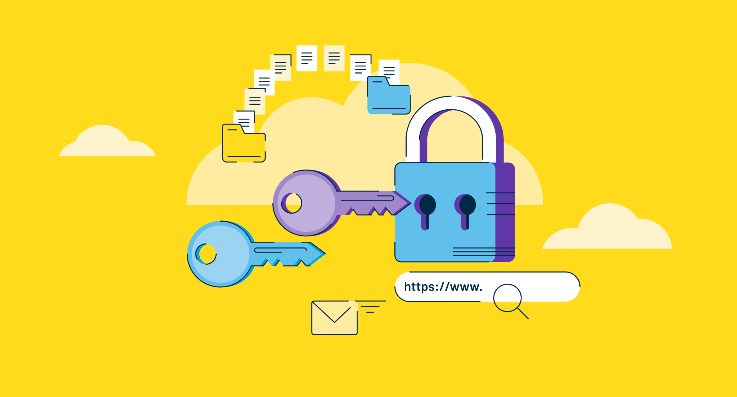
Challenge
Multiple cons to asymmetric encryption
Speed
Decryption takes time
Vulnerabilities
Stolen keys make the encryption useless
Loss
Loss of key prevents any further decryption
Long-term sustainability
Quantum computing

Slide 6

Rebuttal
All encryption techniques have pros and cons
Encryption is absolutely necessary
Value security above all else
Trade security for speed and loss protection by using symmetric

Slide 7
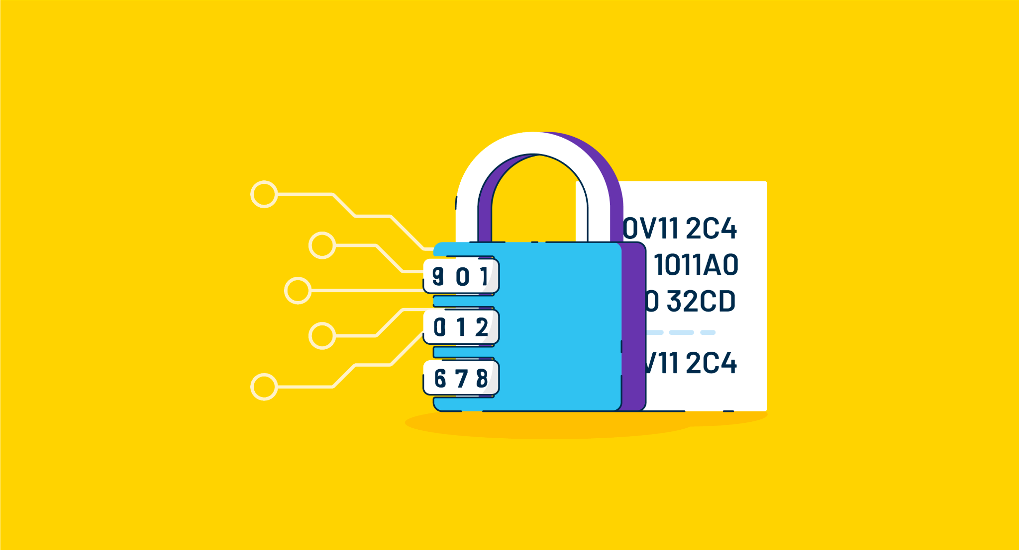
Conclusion
Asymmetric generates two keys over symmetric single key
Need public to encode and private to decode
Symmetric uses one key to encode and decode
Asymmetric has some flaws
Speed, vulnerability, loss, and long term support

Slide 8
Sources
https://www.okta.com/identity-101/asymmetric-encryption/#:~:text=Asymmetric%20encryption%20
https://learn.microsoft.com/en-us/dotnet/standard/security/generating-keys-for-encryption-and-decryption
https://www.ssl2buy.com/wiki/symmetric-vs-asymmetric-encryption-what-are-differences
https://www.thekumachan.com/public-key-directory/

